Slide 1
DA105.C (Monday)
Feel free to add comments. To use the slides, create a copy (file -> make a copy)

Slide 2


DA105 - Data Storytelling
Analysis for Allocating Marketing Budget Part I
While we're waiting to begin,
please answer in the Zoom chat:
Check out the dataisbeautiful subreddit and share a visualization that you admire!
reddit.com/r/dataisbeautiful/

Slide 3
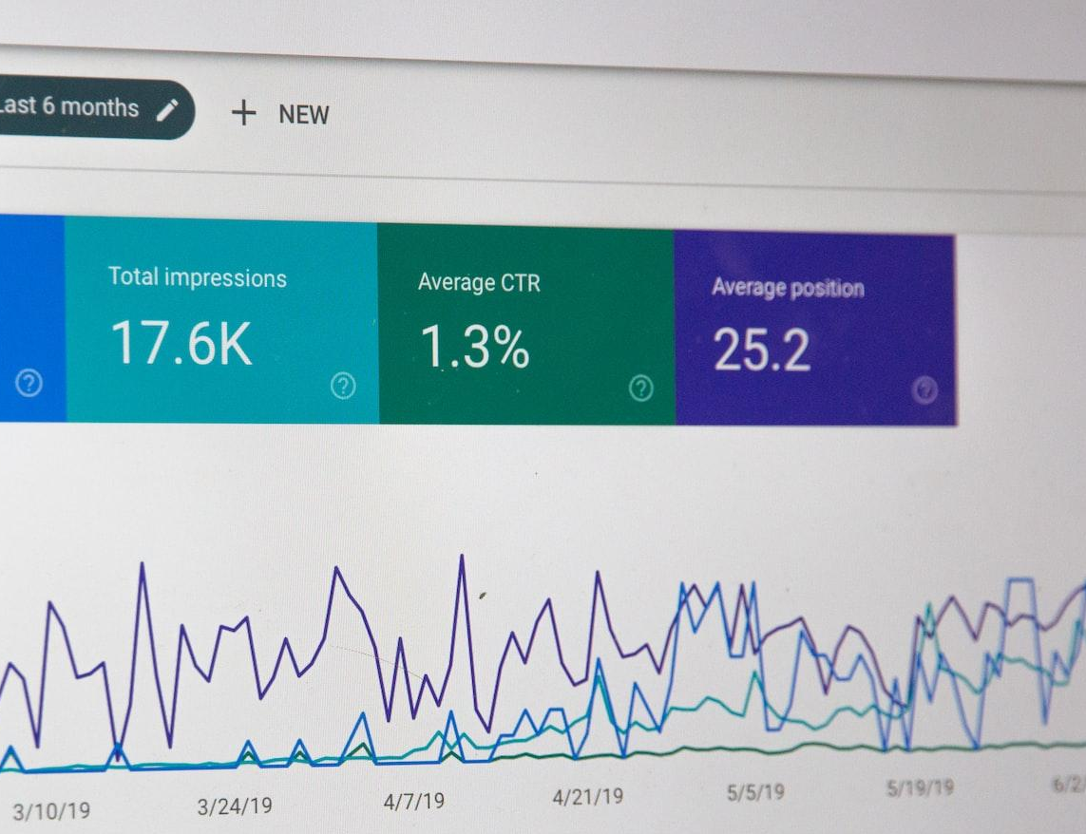
Intro
What we’ll do today
Perform an analysis in Tableau together
Determine which demographic segments should be targeted in the awareness campaign
Part II to follow on Wednesday

Slide 4

Today's Agenda
Intro & Setup
10 min
Dataset Background
5 min
Exploring the Data
10 min
Set the Goal
15 min
Analyze!
20 min
Wrap-up
5 min

Slide 5
Intro

Slide 6






DA105 Business Case
Week 1
Key Messages & Social Media
Week 2
Marketing Budget Analysis
Week 3
Donor Presentation
Week 3
Dashboard & Infographic
Today’s topic: Marketing Budget Analysis (Part I)

Slide 7

This month you are:
Communications Associate
Marcus Patel
Lives in the outskirts of Dublin, Ireland
His role originally focused on writing feature stories but switched to data journalism
Loves any crossroads of art and science – like data visualization!
Still not over the Game of Thrones series finale

Slide 8


Meet your coworker:
Social Media Coordinator
Jasmine Carter
Washington, D.C., USA
Has a strong intuition for what messages will “stick” with audience
Loves painting, and makes the most out of her National Gallery of Art museum membership
Can do a perfect Spongebob Squarepants* laugh (it’s eerily spot-on)
* it’s a children’s cartoon

Slide 9



Business Question
Allocating marketing budget for the campaign
Optimizing our spending
WHO Internal
Jasmine Carter
Marketing budget allocation is the amount of money an organization dedicates to each expense in a marketing plan.
Assuming a set budget for the campaign, we need to prioritize the demographics that could benefit the most from increased awareness.
Jasmine Carter
Marcus Patel (You)
Hope your week is off to a great start, Marcus! I thought you should know: I went to a Game of Thrones paint-and-sip event on Friday, and the Ballmer peak is not a thing for me painting.🙈
Thanks for working hard with me to finish off those edits to the social media posts last week. Let’s keep in close communication for this next step: allocating the budget.
Please do some analysis to recommend which demographics we should target: countries, ages, genders, etc.
Jasmine Carter
Emily Rivera

Slide 10
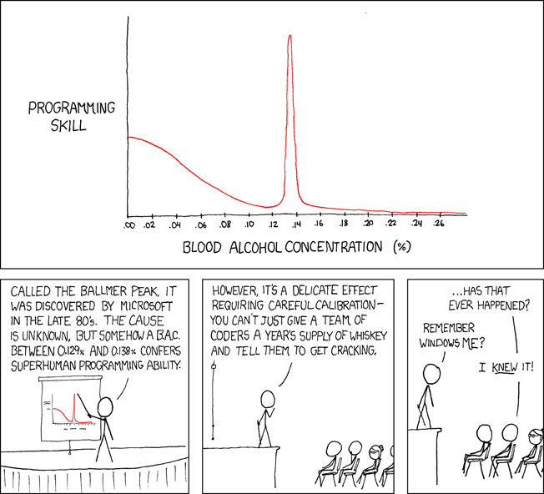
In case you didn’t understand the reference…
Ballmer Peak
Source: xkcd

Slide 11
Setup

Slide 12
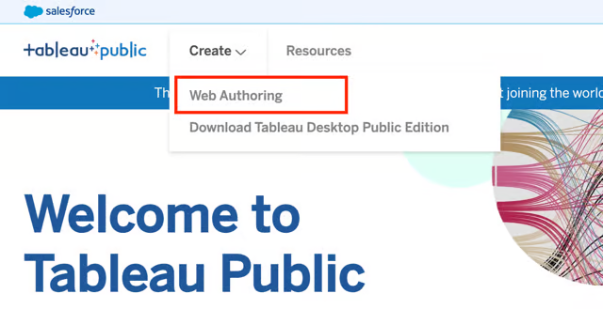
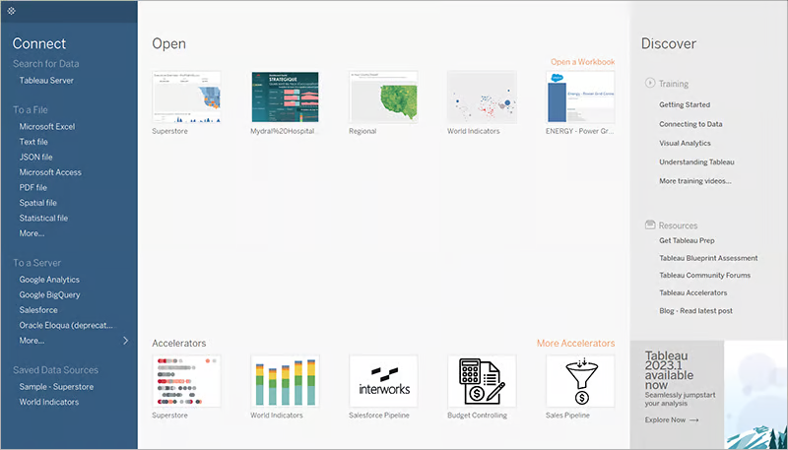
Let’s get set up (links in the chat)
Open Tableau Public
Log in and choose an interface
General guide to Tableau Public
Log in to Tableau Public You should have already created an account.
Two ways to work with Tableau:
Tableau Desktop Public Edition: an application you can download and install on Mac or Windows
Tableau Web Authoring: a more limited browser-based interface

Slide 13
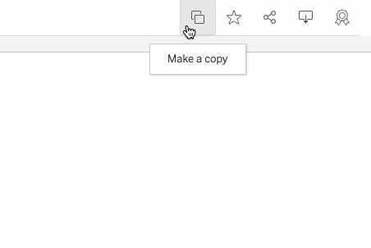
Let’s get set up (links in the chat)
Make a copy of the starter Tableau workbook
How to copy a workbook
Open the link to the workbook and see the icons in the upper right corner:
If you installed Tableau Desktop Public Edition, click Download, then open the file
If you did not install, click Make a copy to use web authoring

Slide 14
What questions do you have?
Feel free to raise your emoji hand or type into the chat.

Slide 15
Dataset Background

Slide 16
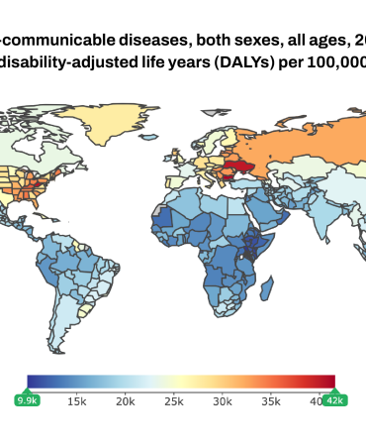
The Data Source
Global Burden of Disease Study
(2019)
“
The Global Burden of Disease (GBD) study provides a comprehensive picture of mortality and disability across countries, time, age, and sex.
It quantifies health loss from hundreds of diseases, injuries, and risk factors, so that health systems can be improved and disparities eliminated.
Source: Institute of Health Metrics and Evaluation (IHME)

Slide 17

The Dataset
Mental Health Disorder Prevalence
Source: Institute of Health Metrics and Evaluation (IHME)
Prevalence is how common something is amongst the population
Columns:
Cause: all mental disorders, by each disorder
Metrics: percent of the population, number of people
Location: global, by country
Age: all ages, by age range (0-9, 9-11,...)
Sex: both, male, female

Slide 18
Exploring the Dataset

Slide 19
Exploring the mental health prevalence dataset
What is a row? Let’s examine.
to Tableau! 🚀

Slide 20
Exploring the mental health prevalence dataset
What is a row?
One row = an aggregated statistic
“[How many / what percent of] people have a particular mental health disorder among this demographic segment (location, age, sex)?”
Aggregating the aggregations: COUNT isn’t useful, SUM is applicable for the number of people
The segments aren’t mutually exclusive
Each country is a part of “global”
Each age range is a part of “all ages”
Each sex is part of “both”
Filters are very important!

Slide 21
What questions do you have?
Feel free to raise your emoji hand or type into the chat.

Slide 22

5-minute break

Slide 23
Set the goal

Slide 24

Raise your emoji hand to speak or type in the Zoom chat
Who should we target with our campaign? Why?
Segments with higher
mental health prevalence
Segments with lower
mental health prevalence

Slide 25

Who should we target with our campaign?
Measurement considerations
Prevalence data is impacted by:
the true prevalence of mental health disorders
the measurement of prevalence, which requires a diagnosis
A person is less likely to be diagnosed if awareness is low, stigma is high, or there’s limited access to services

Slide 26
Who should we target with our campaign?
Measurement considerations
Prevalence data is impacted by:
the true prevalence of mental health disorders
the measurement of prevalence, which requires a diagnosis
A person is less likely to be diagnosed if awareness is low, stigma is high, or there’s limited access to services
The Global Burden of Disease study is a collection of complex estimates → they may try to account for this underdiagnosis factor
You could make a valid argument either way

Slide 27
Who should we target with our campaign?
Segments with higher
mental health prevalence
Segments with lower
mental health prevalence
Let’s target higher prevalence

Slide 28
Raise your emoji hand to speak or type in the Zoom chat
Which metric should we focus on? Why?
Percent of people with a mental health disorder
Number of people with a mental health disorder

Slide 29

Which metric should we focus on?
Metric tradeoff
Number of people: shows the overall size of the affected population → We need to allot more budget for larger populations → Smaller segments get ignored
Percent of people: scaled by the total number of people in the population of that segment → Understand the severity for a particular segment → Smaller segments are equally represented

Slide 30
Which metric should we focus on? Why?
Percent of people with a mental health disorder
Number of people with a mental health disorder
Let’s look at both!

Slide 31
What questions do you have?
Feel free to raise your emoji hand or type into the chat.

Slide 32
Analyze!

Slide 33
Determining the target demographic
Which segments have higher prevalence?
to Tableau! 🚀

Slide 34
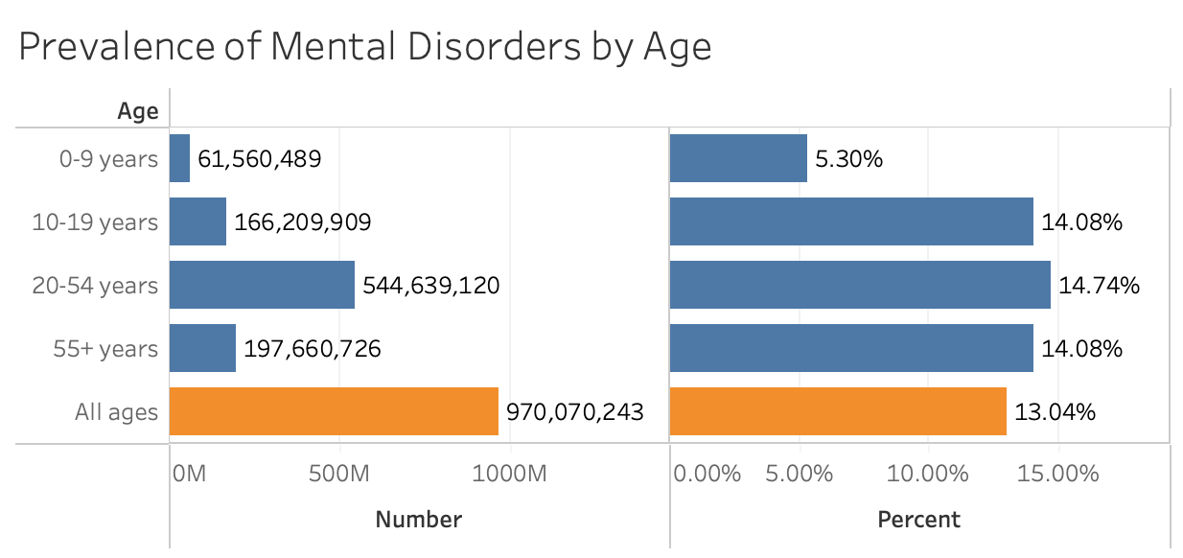
Which segments have higher prevalence?
Adults are the most affected
Higher both in percent and number of people

Slide 35
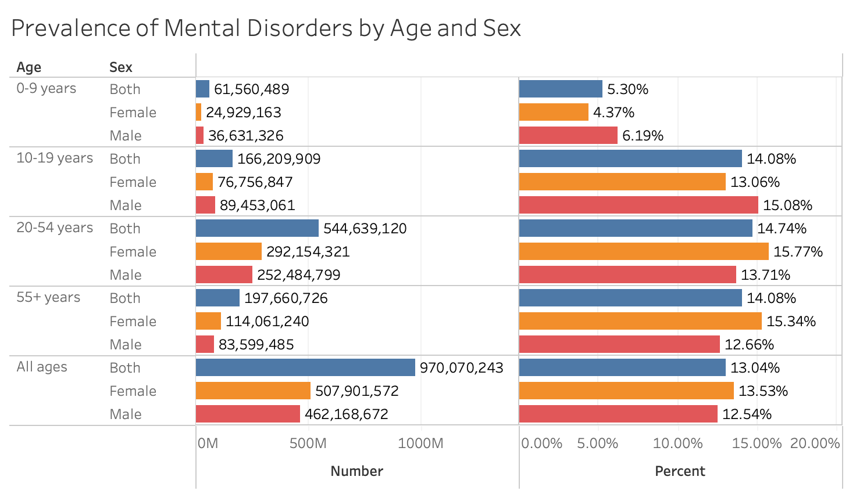
Which segments have higher prevalence?
Female in adulthood but male in youth

Slide 36
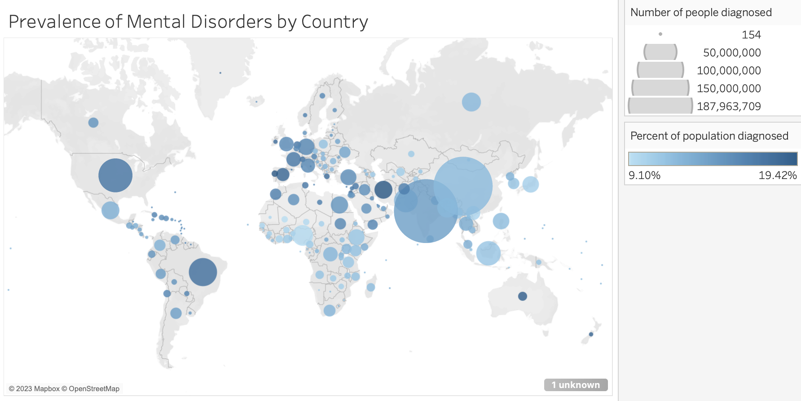
Which segments have higher prevalence?
Western Europe, Middle East, parts of Americas

Slide 37
Business Question
Allocating marketing budget for the campaign
Good work so far! Let’s check in with Jasmine.
WHO Internal
Jasmine Carter
Marcus Patel
It’s often a good idea to send some initial insights partway through an analysis to get some feedback.
If it turns out that our stakeholder had something else they wanted, we still have time to iterate!
Looks like Jasmine had something more specific in mind.
Here are a couple of quick insights. I used data on the prevalence of mental disorders in different countries.
The most affected segments are:
• Adults
• Female in adulthood but male in youth
• Western Europe, Middle East, parts of Americas
Marcus Patel (You)
Jasmine Carter
Emily Rivera
Jasmine Carter
Thanks, Marcus! This is on the right track, but we need a more granular budget plan. How much of our budget should we be spending on each segment?

Slide 38
What questions do you have?
Feel free to raise your emoji hand or type into the chat.

Slide 39

Wrap-up
We’ll continue with this analysis on Wednesday.
Campus material is live and available 24/7.
Use Chat Bubble as much as you need!
Reach out w/ questions via Slack.

Slide 40
DA105 Business Case
Week 1
Key Messages & Social Media
Week 2
Marketing Budget Analysis
Week 3
Donor Presentation
Week 3
Dashboard & Infographic
Wednesday’s topic: Marketing Budget Analysis (Part II)

Slide 41
Thank You
And Keep Practicing!
Notes:
End of Presentation slide

